Slide 1
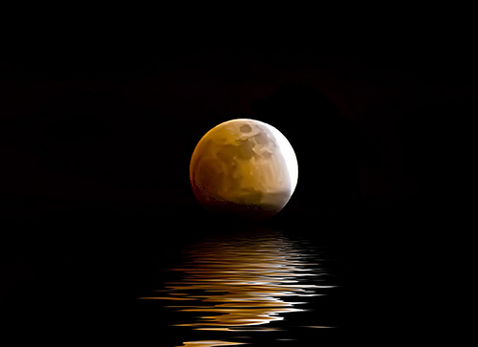


Slide 2
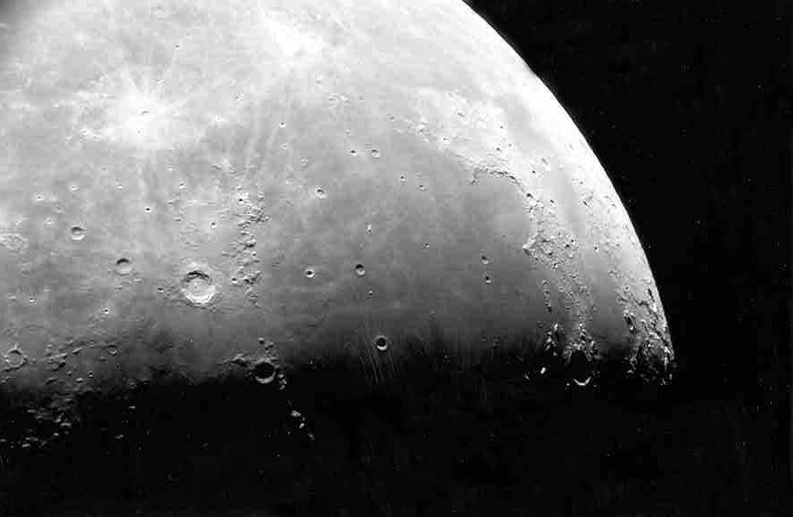
Photo by Jim Fullerton
Moon maré as seen through the telescope.

Slide 3
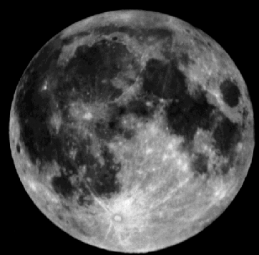
The maria (maré) are the smooth dark areas on the surface of the Moon.
maré
highlands

Slide 4
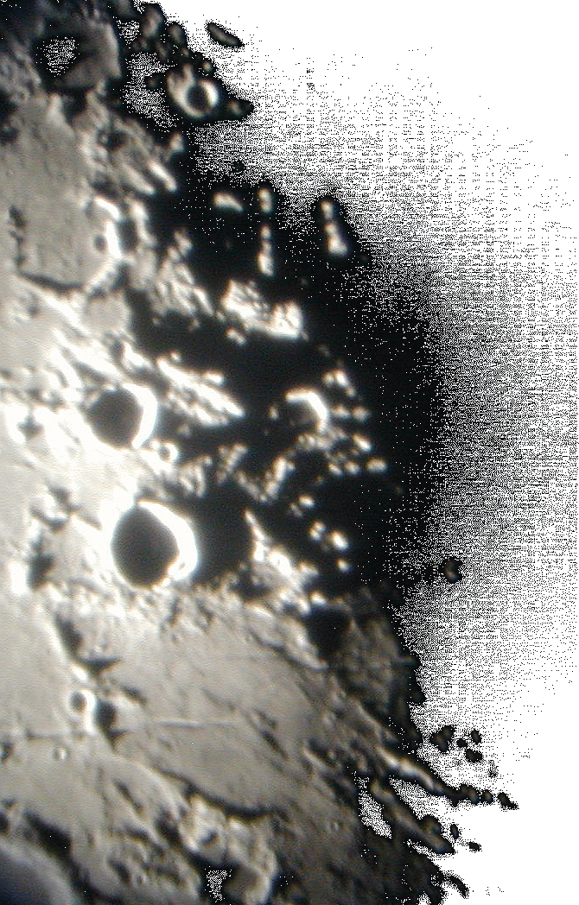
The Moon=s many features are best seen near the terminator - the line between day and night.
Photo by Lake Afton Public Observatory

Slide 5
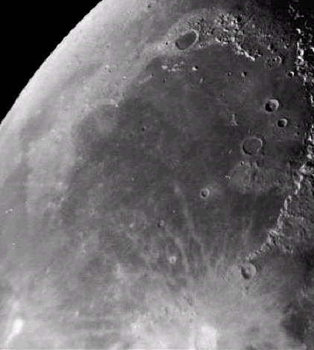
The maria were formed about 3.5 – 4 billion years ago when lava flowed through cracks in the lunar surface and filled in low laying areas.
Mare Imbrium

Slide 6
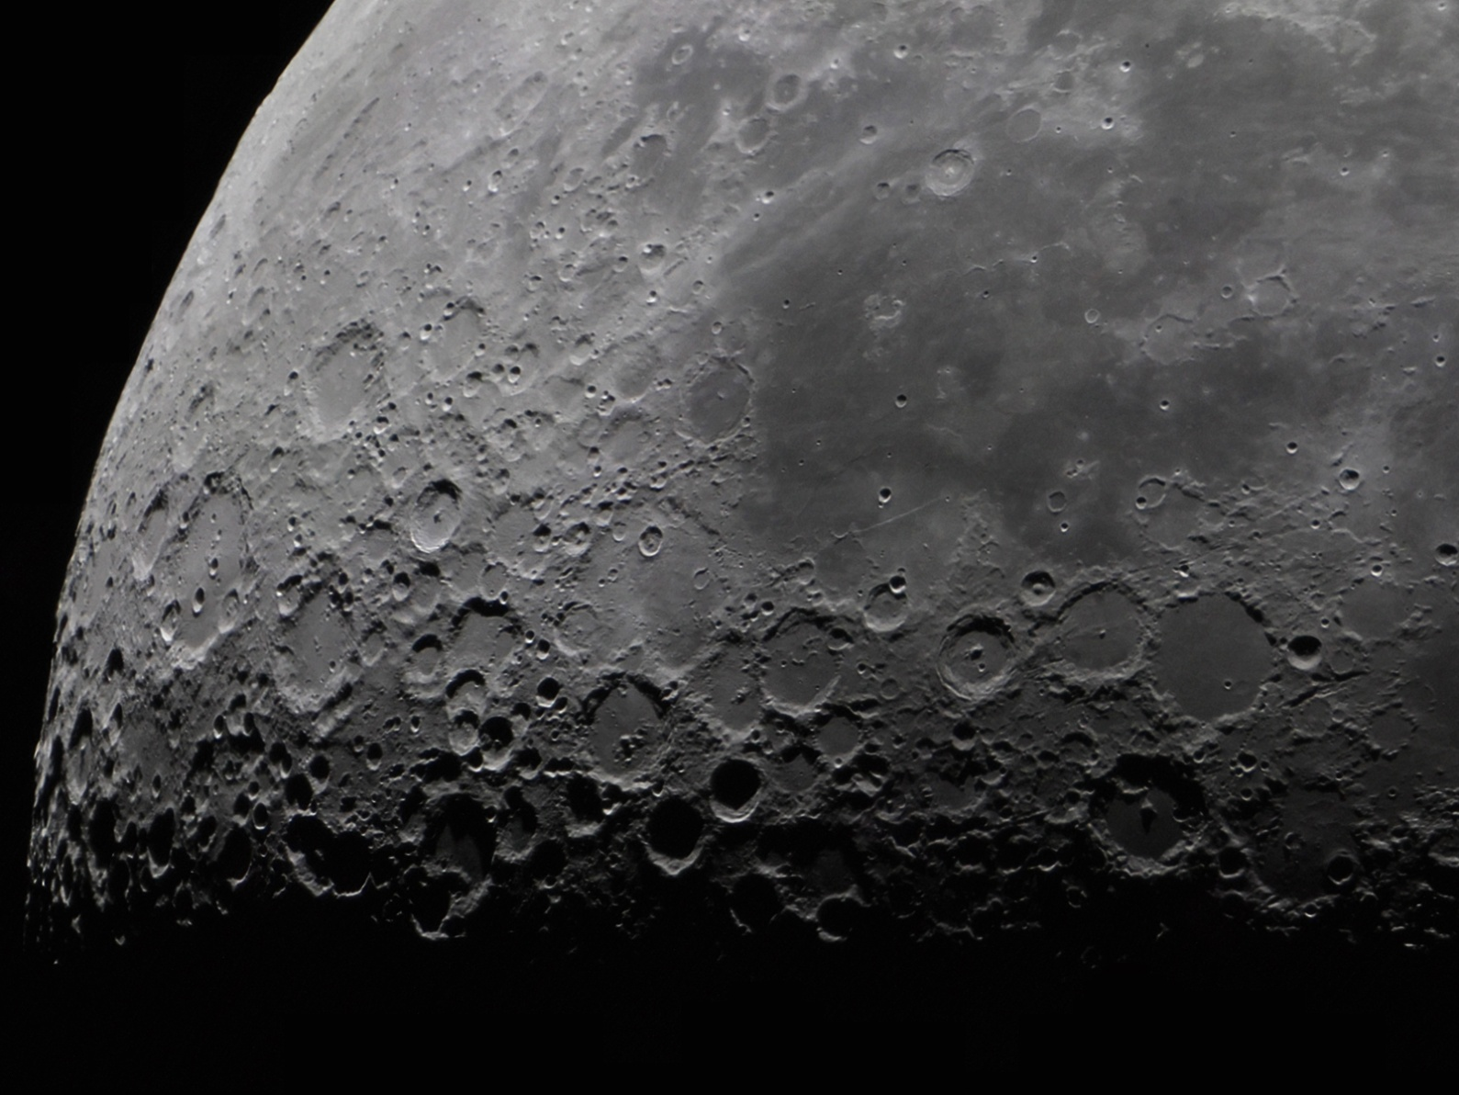
Maré
Highlands
The maré are younger than the highlands. This is evidenced by the smaller number of craters on them as compared to the highlands.

Slide 7
This photo shows a smooth-floored lunar maré. You
can easily recognize
the ancient rim of
the original impact
basin, now a
mountain range.
Mare Imbrium

Slide 8
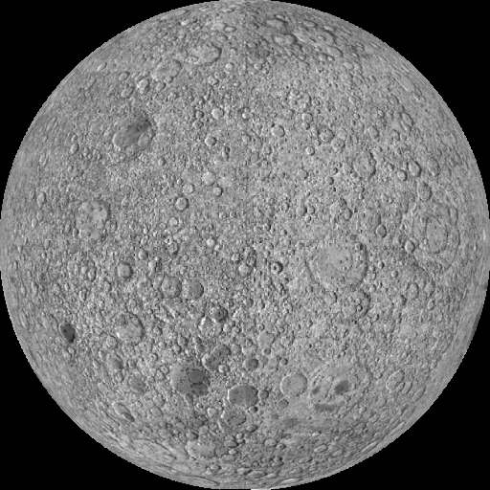
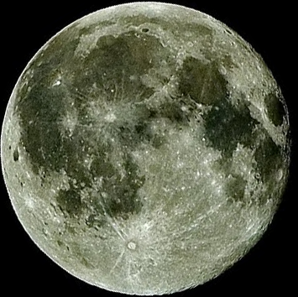
The Moon always keeps one face toward Earth. The far side of the Moon can only be seen by spacecraft and it has almost no maré.
Far Side
Near Side

Slide 9
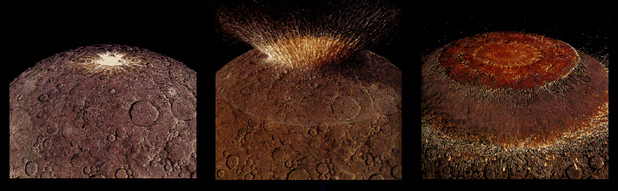
Four billion years ago the impact from a large asteroid formed a huge multi-ringed basin which then thinned and fractured the lunar crust.

Slide 10
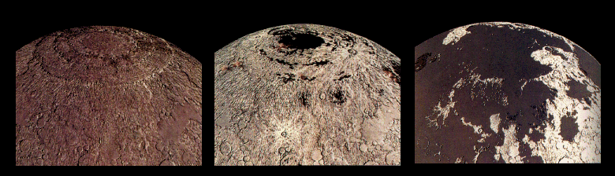
Fluid lavas from beneath the moon’s crust flowed out and flooded the low regions of the lunar surface – filling in many craters.

Slide 11
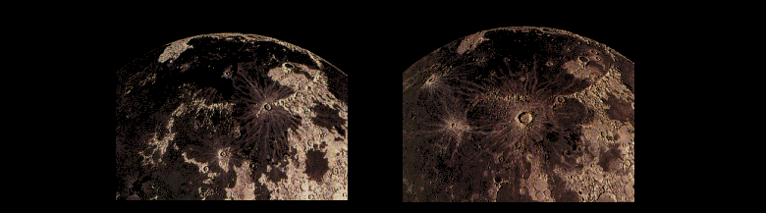
Less than a billion years after they began, the lavas ceased flowing out onto the Moons surface. However, occasionally new craters were created on top of these ancient flows.

Slide 12
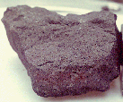
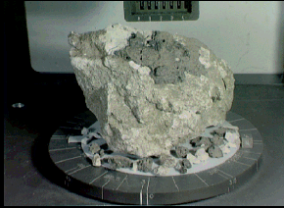
Rock samples from the moon’s maré are dark colored rocks called basalt.
Samples from the highland regions are light gray rocks called anorthosite.

Slide 13
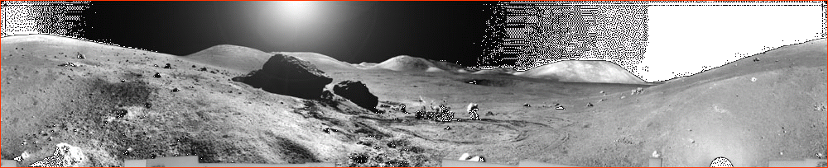
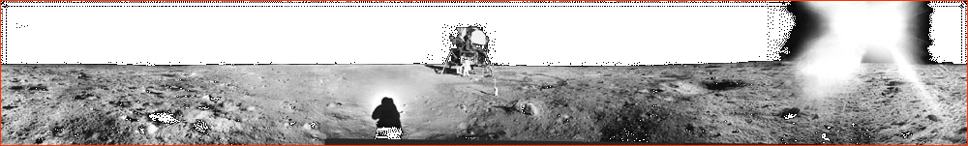
One of these images shows the lunar surface from a maré and the other, the highlands.
Can you tell which is which?

Slide 14
The highlands are rugged.
The maré are smooth & flat.

